Slide 1
LWC. Use it now
github.com/Salesforce-By-Meetup/LWC-Webinar

Slide 2
Yakov
Veromeev
Salesforce Developer,
VRP Consulting
Github: JackVeromeev

Slide 3
Best Practices

Slide 4
LWC Best Practices
Component data management:
Storing

Slide 5
LWC Best Practices
Component data management: Storing
Task: Phone input
There is a phone input with template (3digits) 3digits-2digits-2digits [restDigits]
The value is set from outside
When focus, the editor sees only the numbers
When the value is edited and focus is left, the template should be applied back.
demo: dataStoringDemoContainer

Slide 6
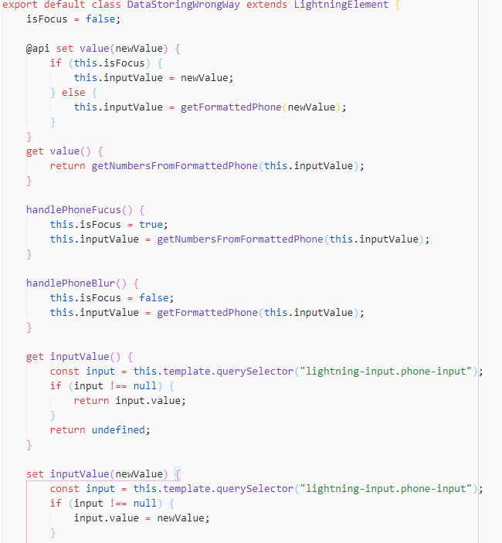
Component data management:
Storing
The data of the component should be stored in the component's class and passed as properties to the child components.
Bad way: by getting the value – store it in one of the components in the template

Slide 7
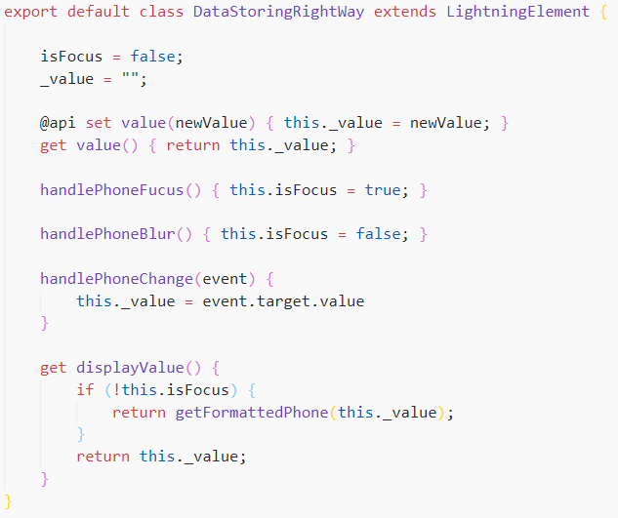
Component data management:
Storing
The data of the component should be stored in the component's class and passed as properties to the child components.
Better way: by getting the value – store it in the field. Template updates automatically.

Slide 8
LWC Best Practices
Component data management:
Changing

Slide 9
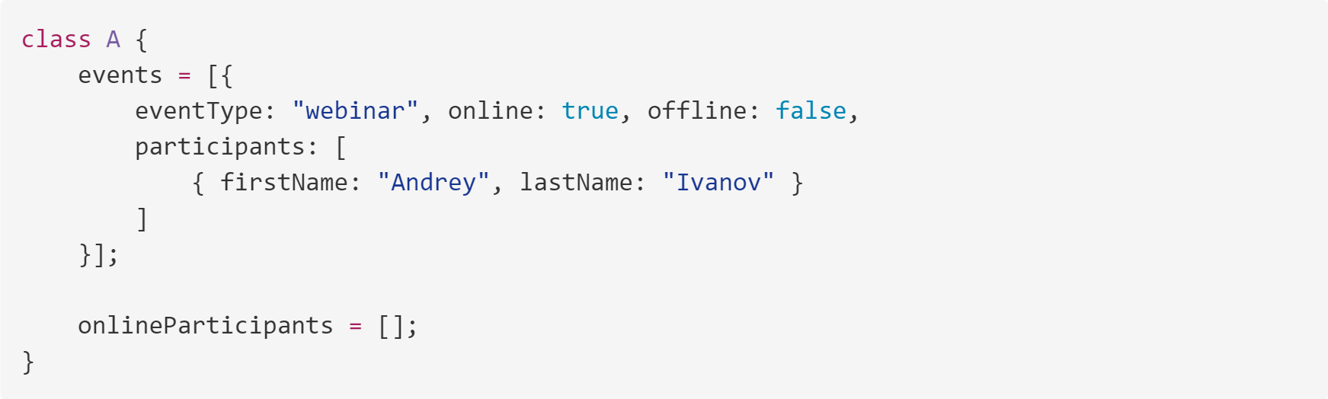
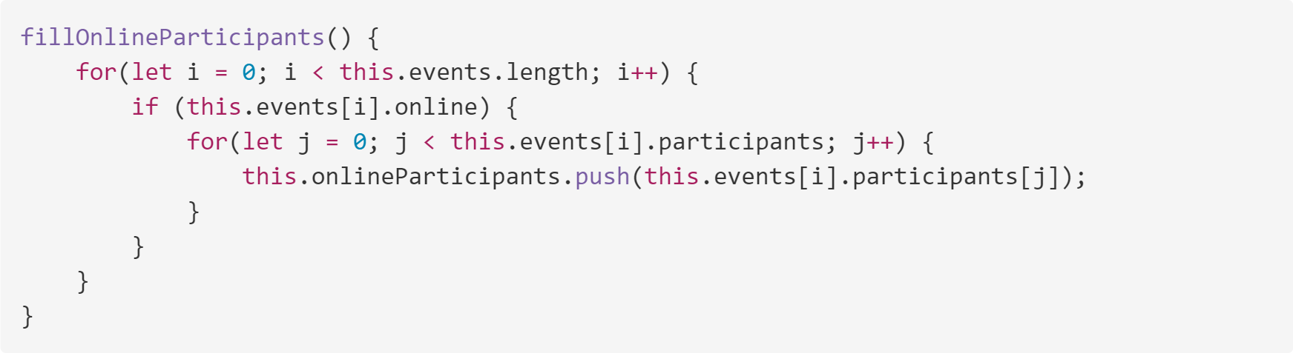
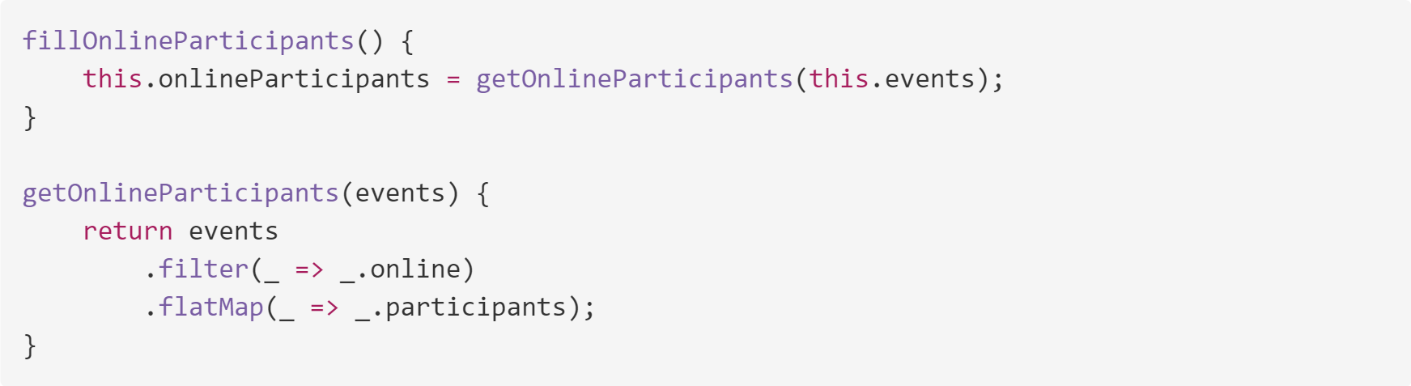
Component data management:
Changing
Every data change should
Get required data
Process it
Assign the result to the class field

Slide 10
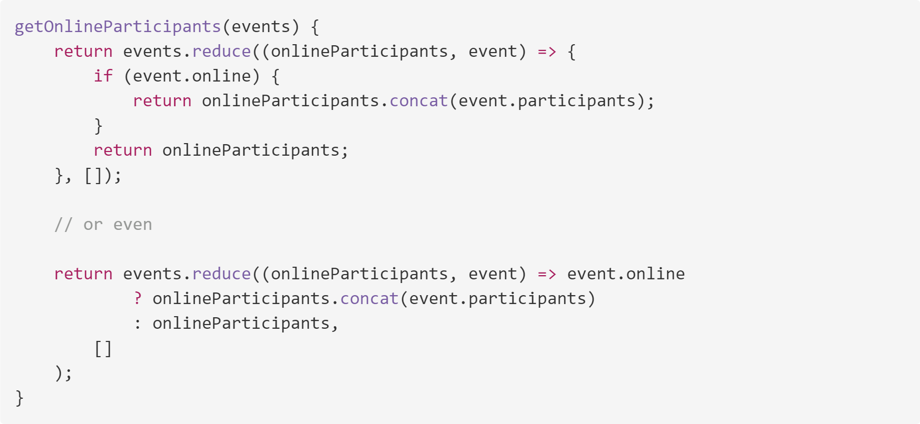
Component data management:
Changing
Every data change should
Get required data
Process it
Assign the result to the class field

Slide 11
LWC Best Practices
Component data management:
Passing data through component tree

Slide 12
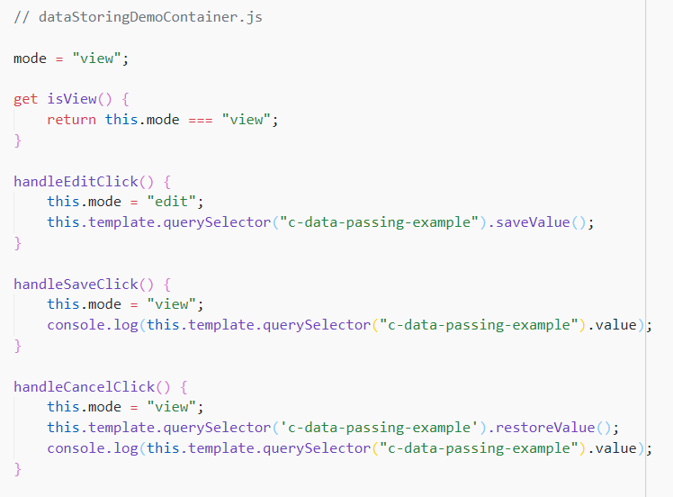
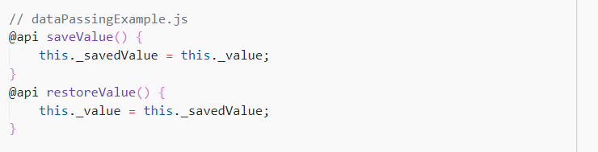
Component data management:
Passing data through component tree
You need to create an read/edit field with availability to cancel the changes. So you need to pass mode (view/edit) and data there.
But do you need to keep the initial and changed data in the component? Not really
That is the case where you can still use querySelector

Slide 13
LWC Best Practices
Code splitting, import/export

Slide 14
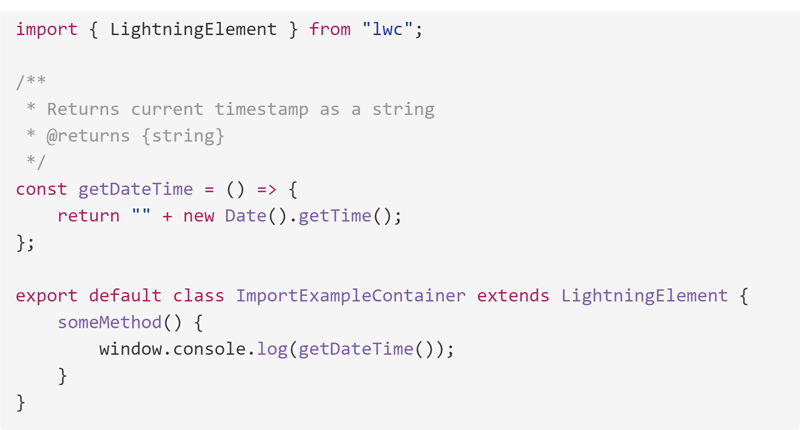
Code splitting, import/export
The same file
Component-specific logic in small components
Only in the file where declared
Method: handleSameFileUpdateClick

Slide 15
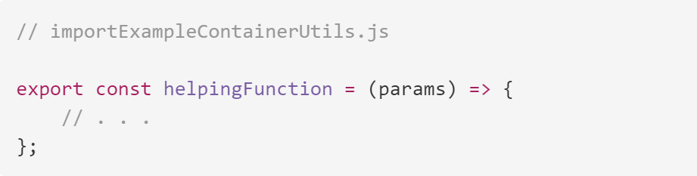
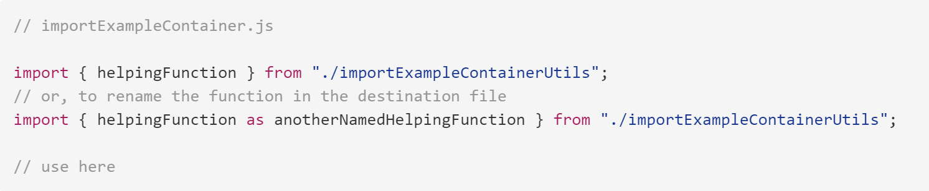
Code splitting, import/export
Another file in the component
Component-specific resources in components with a lot of logic
Only in the bundle where declared - other JS files that are not imported in the source files
Method: handleAnotherFileUpdateClick

Slide 16
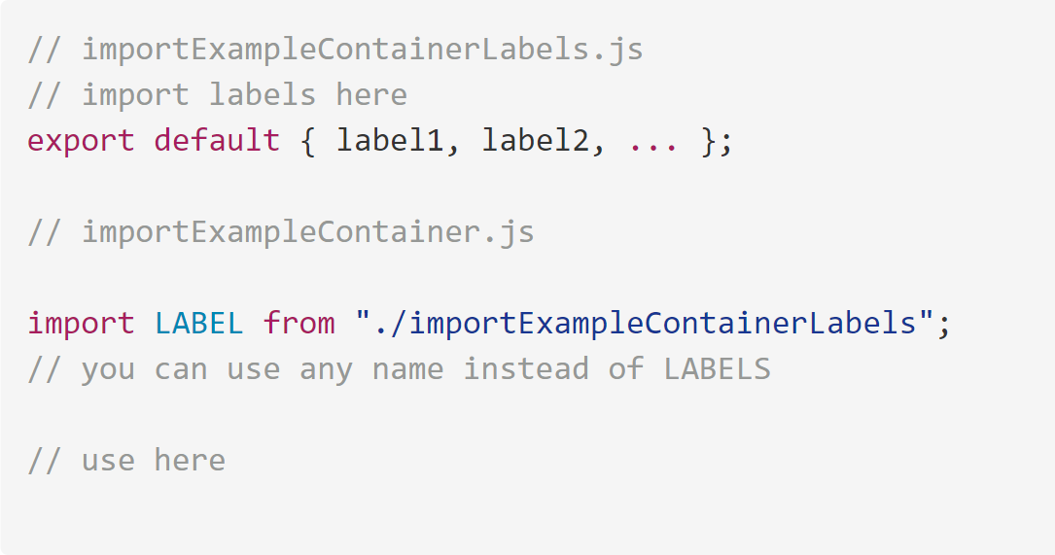
Code splitting, import/export
Another file in the component (default)
Single component-specific resource
Only in the bundle where declared - other JS files that are not imported in the source files
Method: handleAnotherFileDefaultUpdateClick

Slide 17
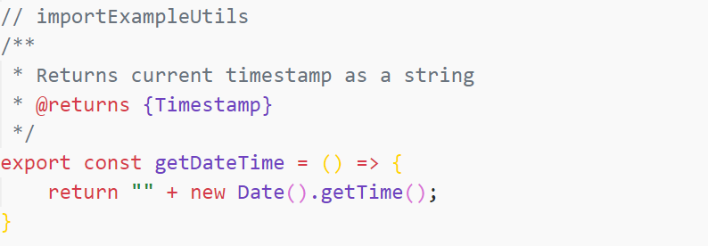
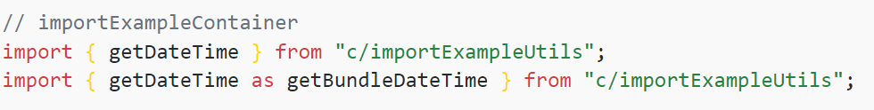
Code splitting, import/export
In another bundle
Resource used in multiple components
In other LWC bundles
Method: handleBundleUpdateClick

Slide 18
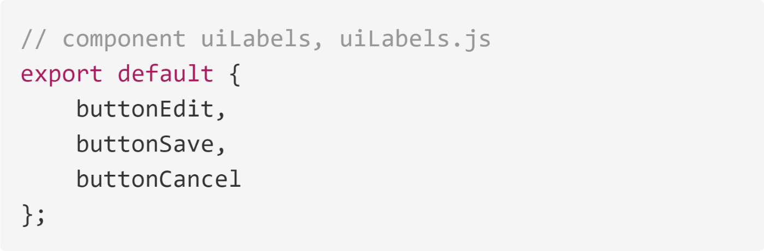
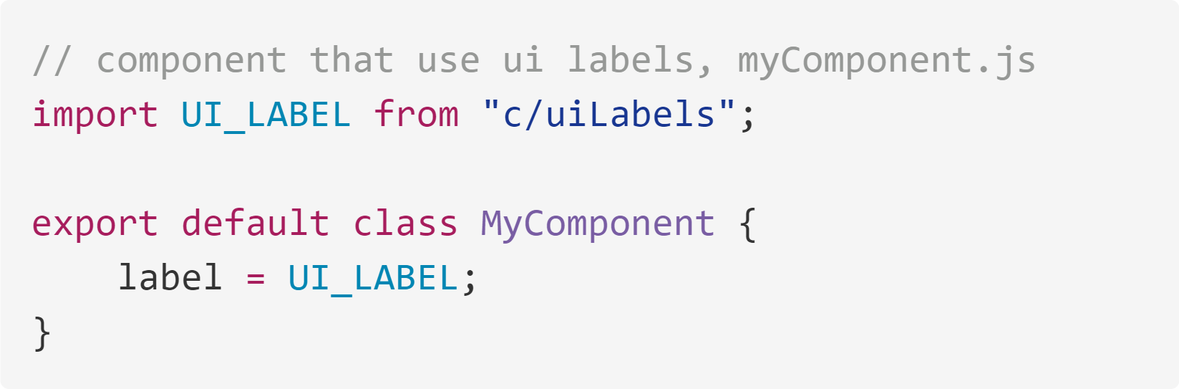
Code splitting, import/export
In another bundle (default)
Single resource used in multiple components
In other LWC bundles
Method: handleBundleDefaultUpdateClick

Slide 19
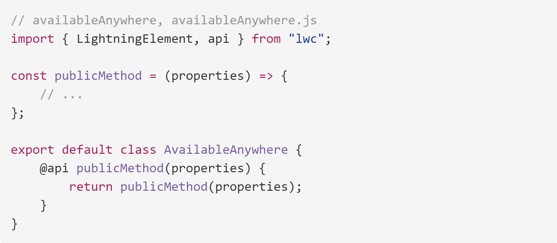
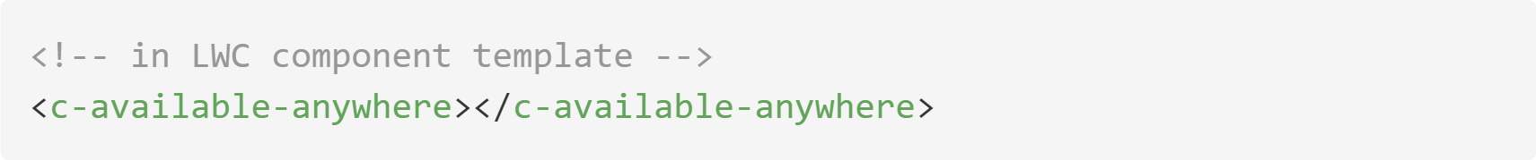
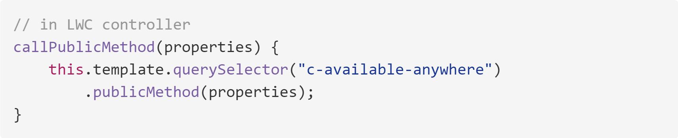
Code splitting, import/export
In another component
Resource used in multiple components
In other LWC and Aura bundles
Method: handleComponentUpdateClick

Slide 20
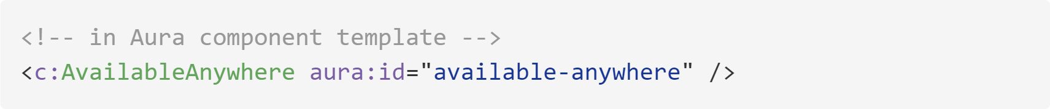
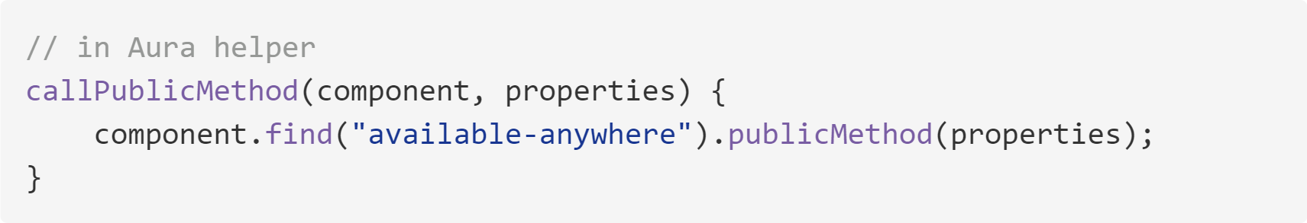
Code splitting, import/export
In another component
Resource used in multiple components
In other LWC and Aura bundles

Slide 21
LWC Best Practices
Documenting, typing

Slide 22

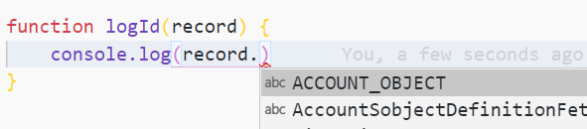
Documenting, typing
Types

Slide 23
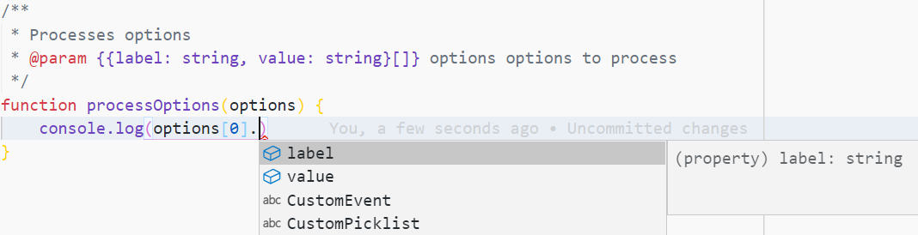
Documenting, typing
Types
Any type should be in {}, first comes field name, then it's type after a colon
JS supports it's primitives: number, string, boolean
Objects are declared as brackets with fields in it separated by a comma
Arrays are declared as Array<TYPE> or TYPE[]
If you want to create a type for Map-like structure which looks like an object, you can use
Object.<KEY_TYPE, VALUE_TYPE> or {[KEY_NAME: KEY_TYPE]: VALUE_TYPE}
If you want to specify a standard payload for custom event, set it as CustomEvent<PAYLOAD_TYPE>, event.detail automatically will capture the type passed here.
functions can be declared as (param1:PARAM_1_TYPE, ...) => RETURN_TYPE or via @callback declaration separately

Slide 24
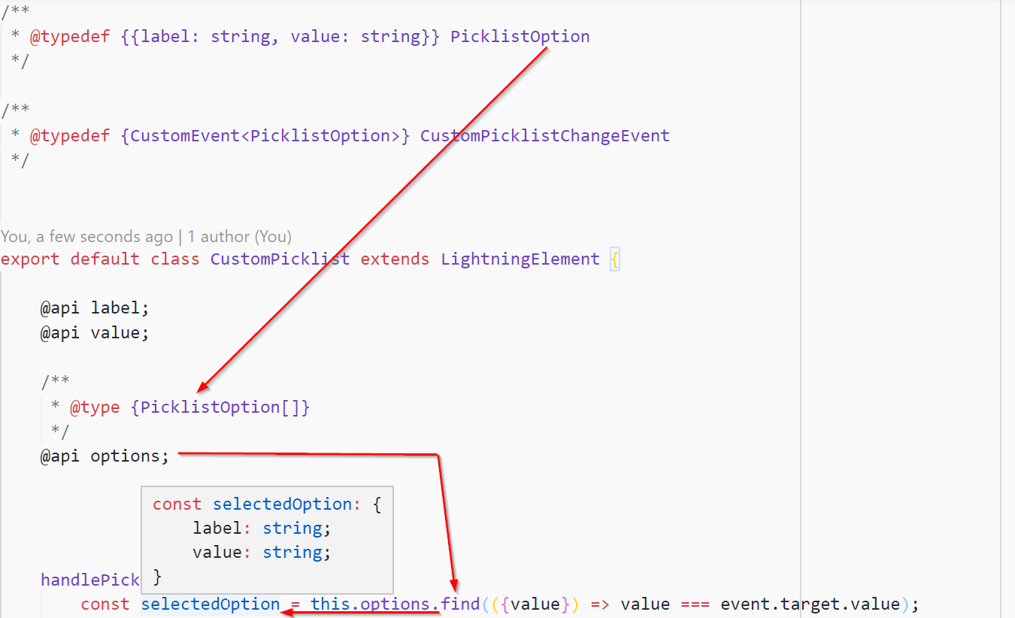
Documenting, typing
Re-usable (even importable) types: @typedef

Slide 25
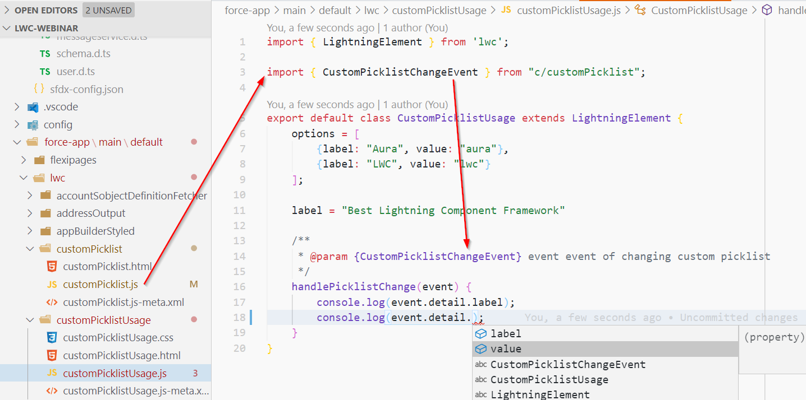
Documenting, typing
Re-usable (even importable) types: @typedef

Slide 26
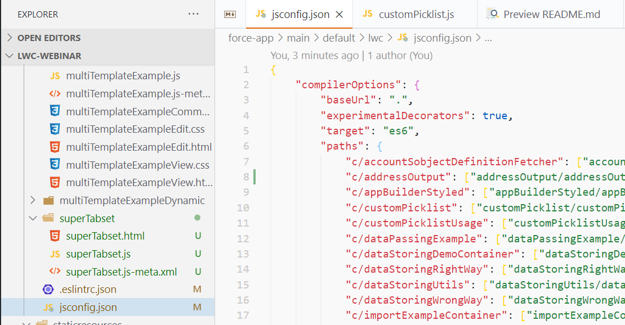
Documenting, typing
Importable types: @typedef. Why it works

Slide 27
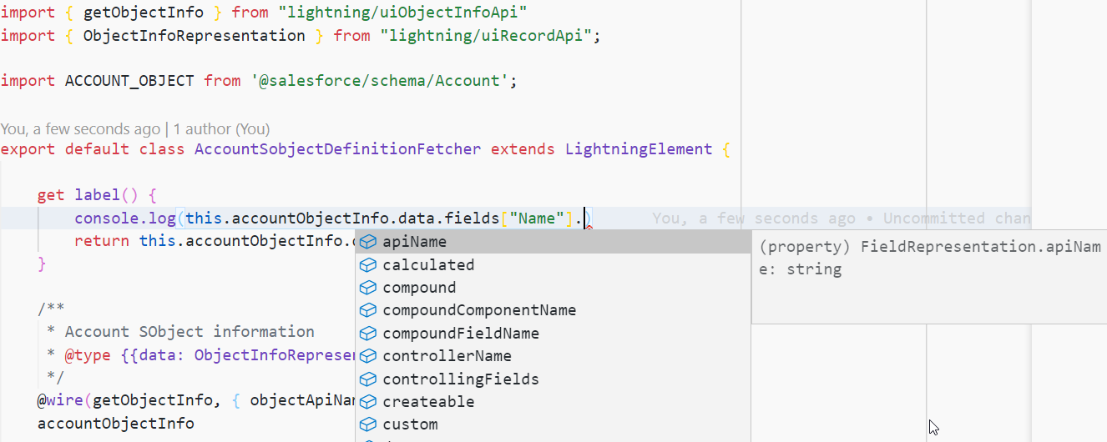
Documenting, typing
Standard types

Slide 28
LWC Best Practices
Documenting, typing: recommendations
If the type is local only, you can declare it in a main JS file or in a separate helper if the type needs to be used in many internal JS files
If the type is for multiple components that interact with your component (like PicklistOption in the example), define it in the component
If the type is for multiple components and there's no root component for it, or many component files want to use it and it should be exported as well, then create a separate component (like commonTypes) and declare the type there
Your component classes don't need to have types by @typedef, you can export it and use as type in JSDoc comments

Slide 29
Tips and tricks

Slide 30
Tips and tricks
Multiple templates

Slide 31
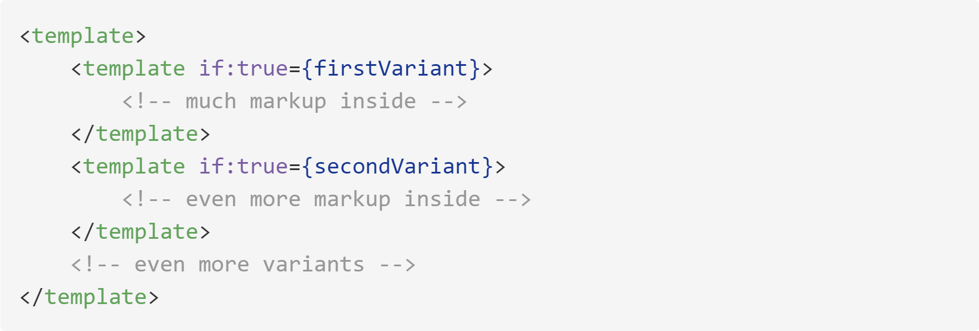
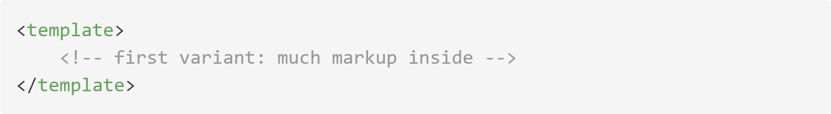
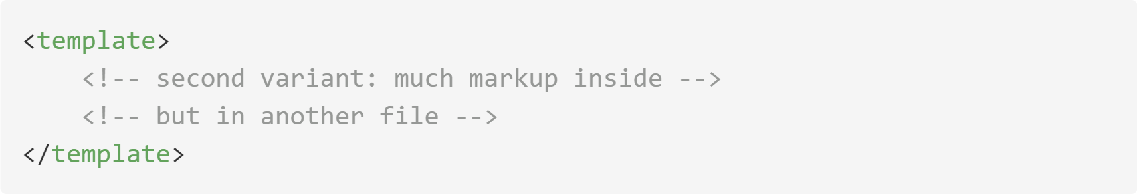
Multiple templates
OR

Slide 32
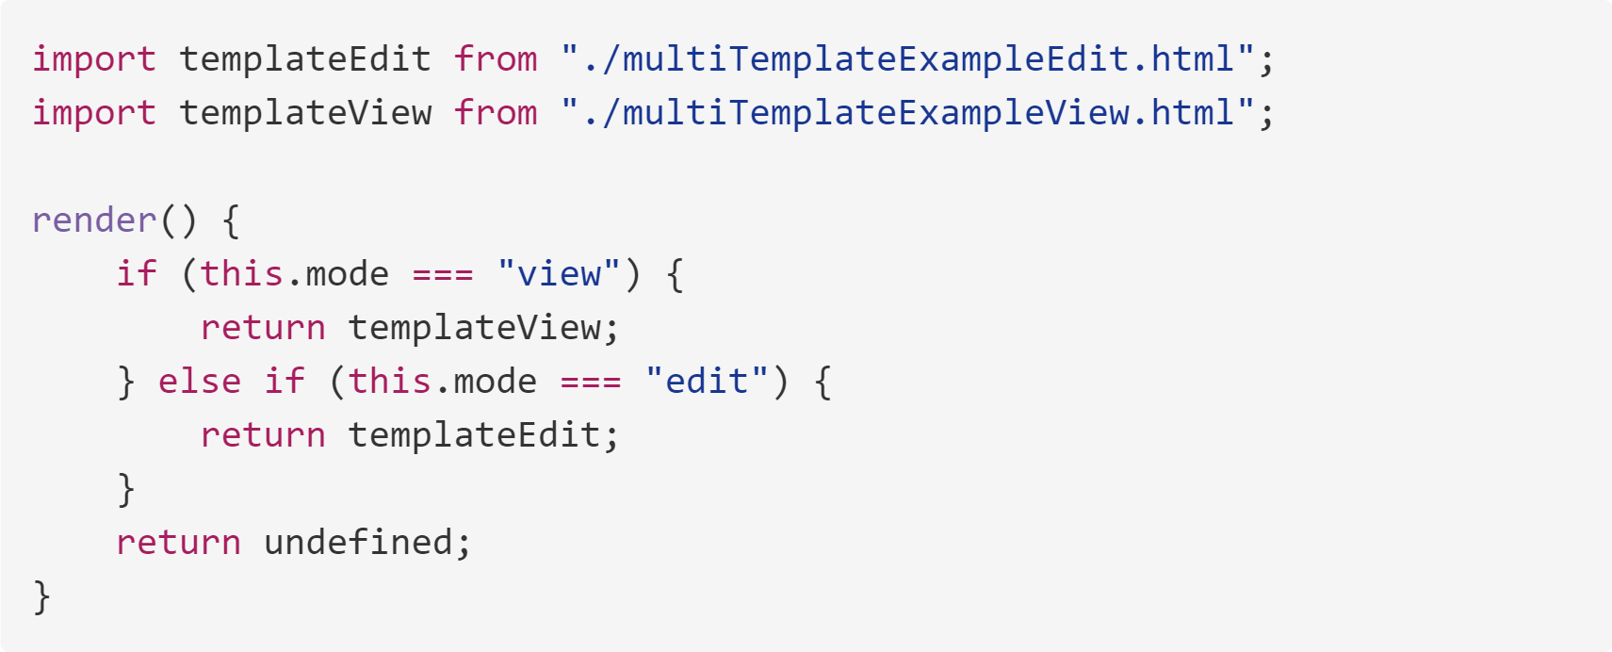
Multiple templates
Demo: multipleTemplateExample

Slide 33
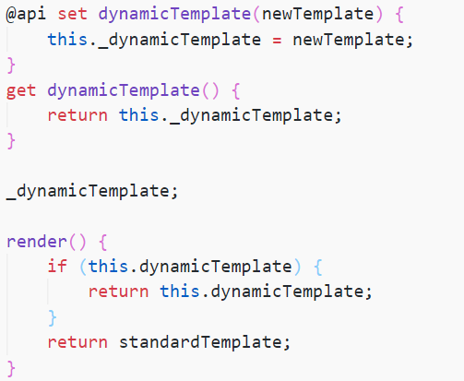
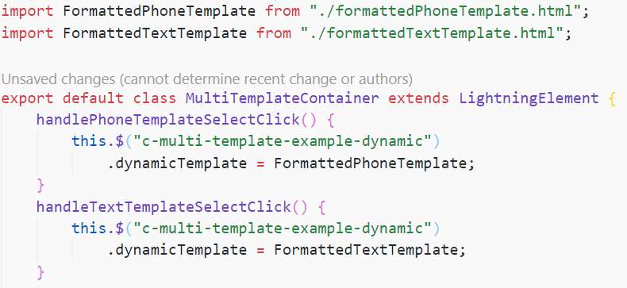
Dynamic templates?
Yes! Demo: multipleTemplateExample

Slide 34
Tips and tricks
Re-usable CSS

Slide 35
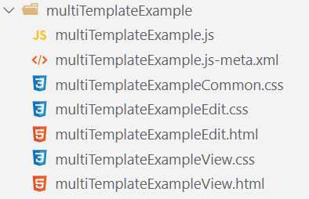
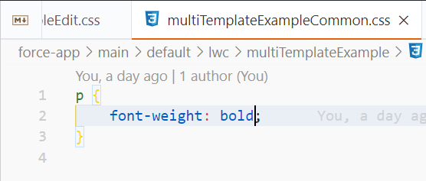
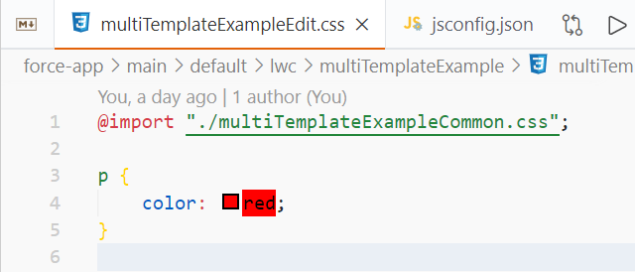
Re-usable CSS. Inside component
Demo: multipleTemplateExample

Slide 36

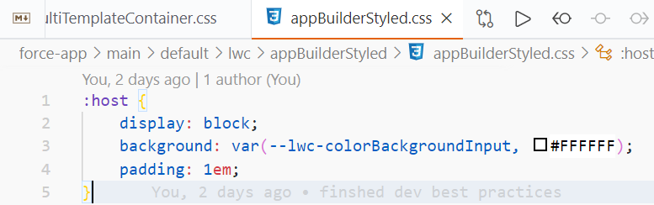
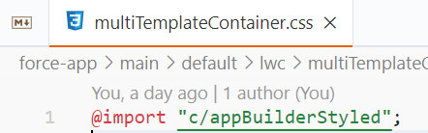
Re-usable CSS
Demo: appBuilderStyled

Slide 37
Tips and tricks
Slot discovery

Slide 38
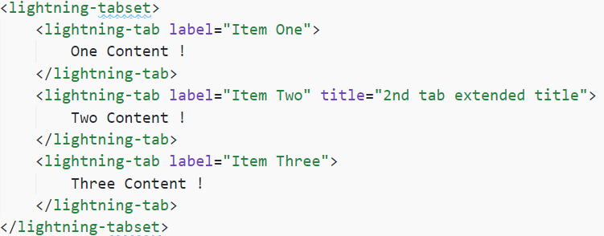
Slot discovery

Slide 39
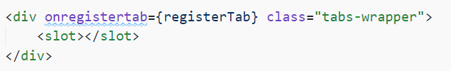
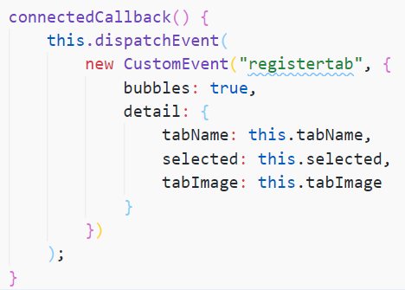
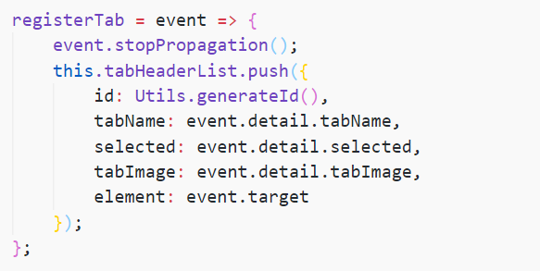
Slot discovery
Child throws “register” event
Parent gets it and stores event.target
On parent’s click it finds a child and shows it removing the others

Slide 40
Tips and tricks
Mixins

Slide 41
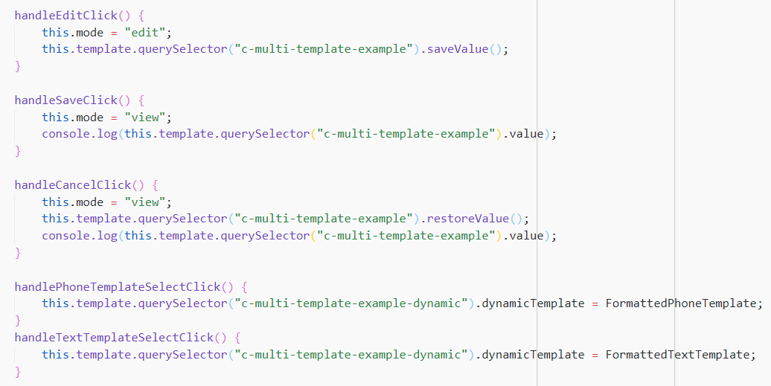
Mixins

Slide 42
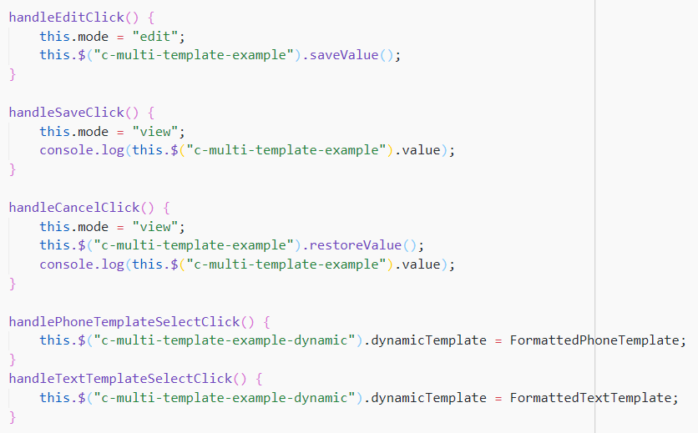
Mixins

Slide 43
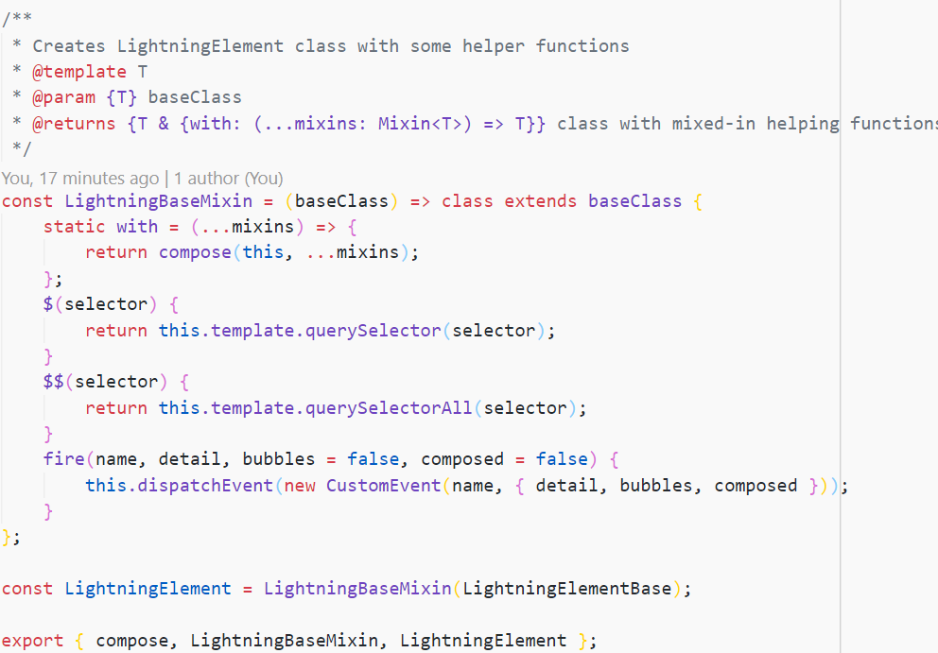
Mixins

Slide 44
Tips and tricks
Hacking standard elements markup

Slide 45
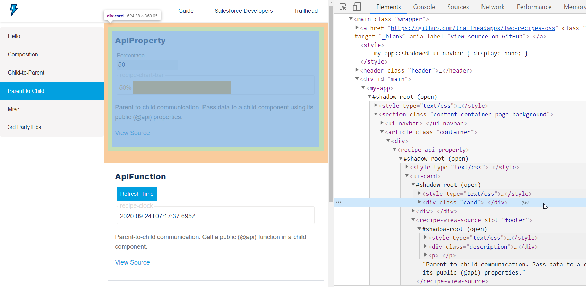
Hacking standard elements markup
https://recipes.lwc.dev/#parent

Slide 46
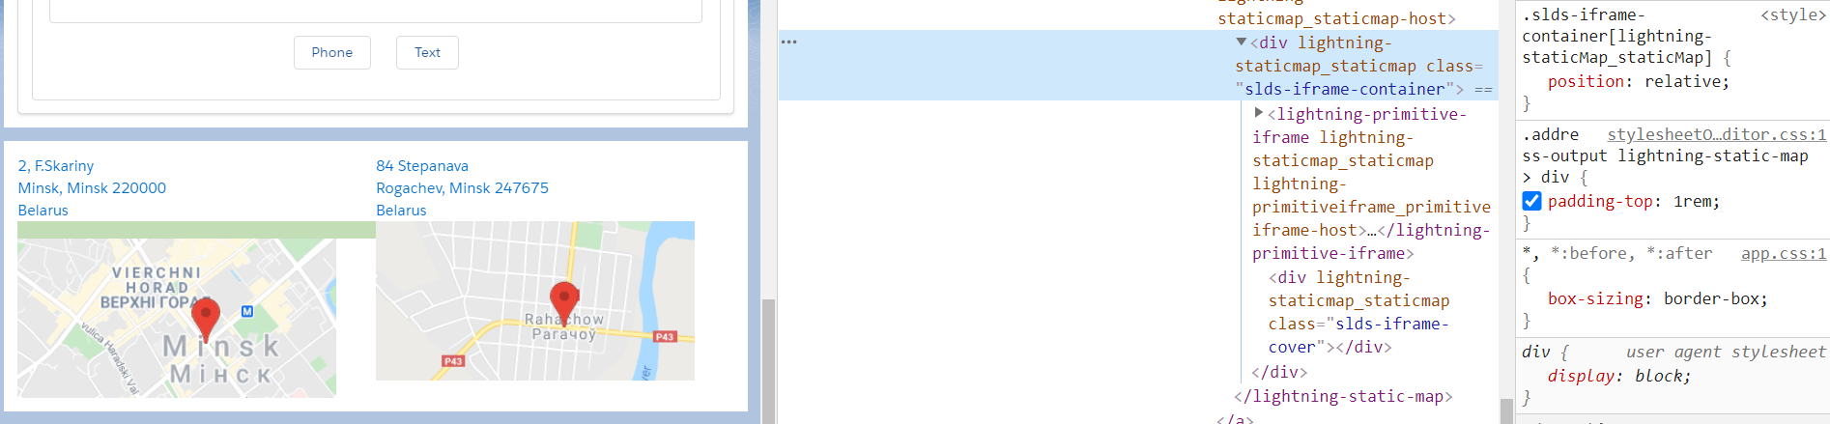
Hacking standard elements markup
Demo: addressOutput

Slide 47
Q&A

Slide 48
Thank you for watching!

